Slide 1
Milepæl A
Gruppe 2: LHEK

Slide 2
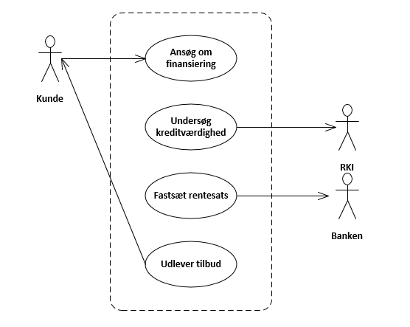
BPR: Use Case Diagram

Slide 3
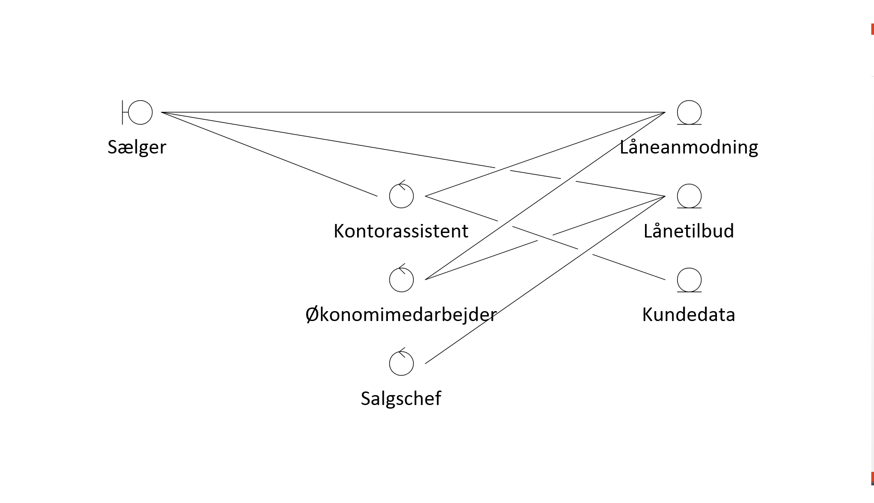
BPR Analyse: Objekt Model

Slide 4
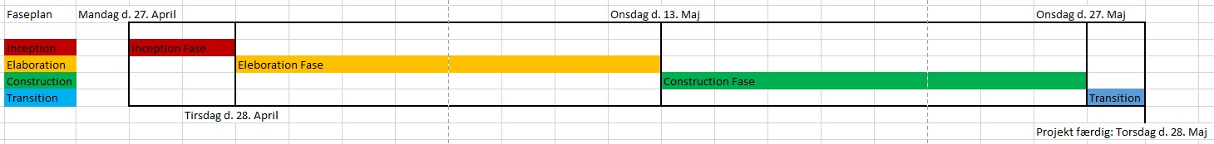
Faseplan

Slide 5
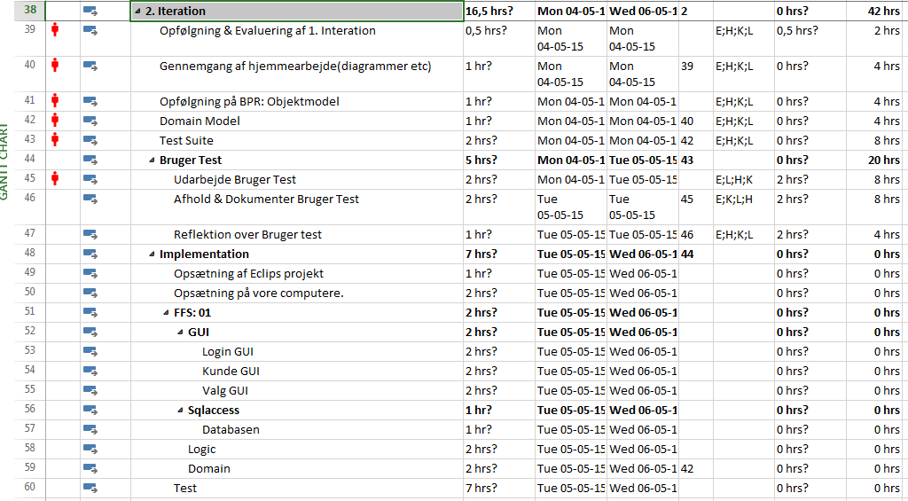
Plan for Iteration 2

Slide 6
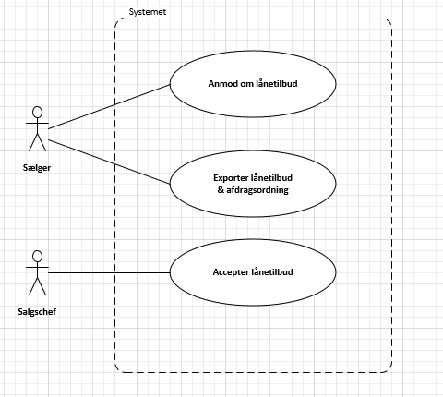
Use Case Diagram

Slide 7
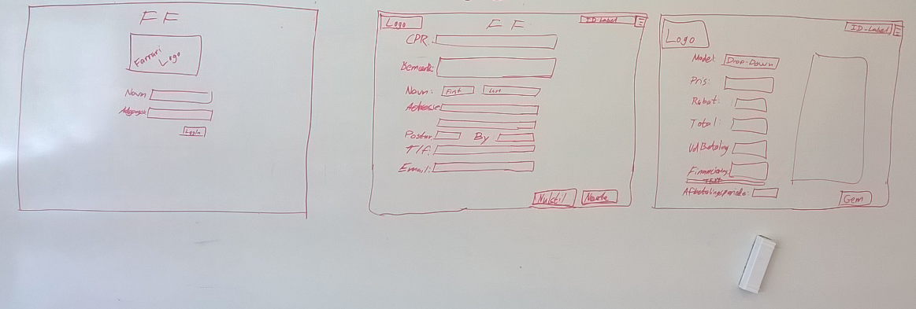
Mockups for FF1

